Slide 1
Intro to Jupyterlab
A guide to the jupyterlab user interface

Slide 2
Objectives :
Learn about the Jupyterlab environment
Practice basic tasks in Jupyterlab

Slide 3
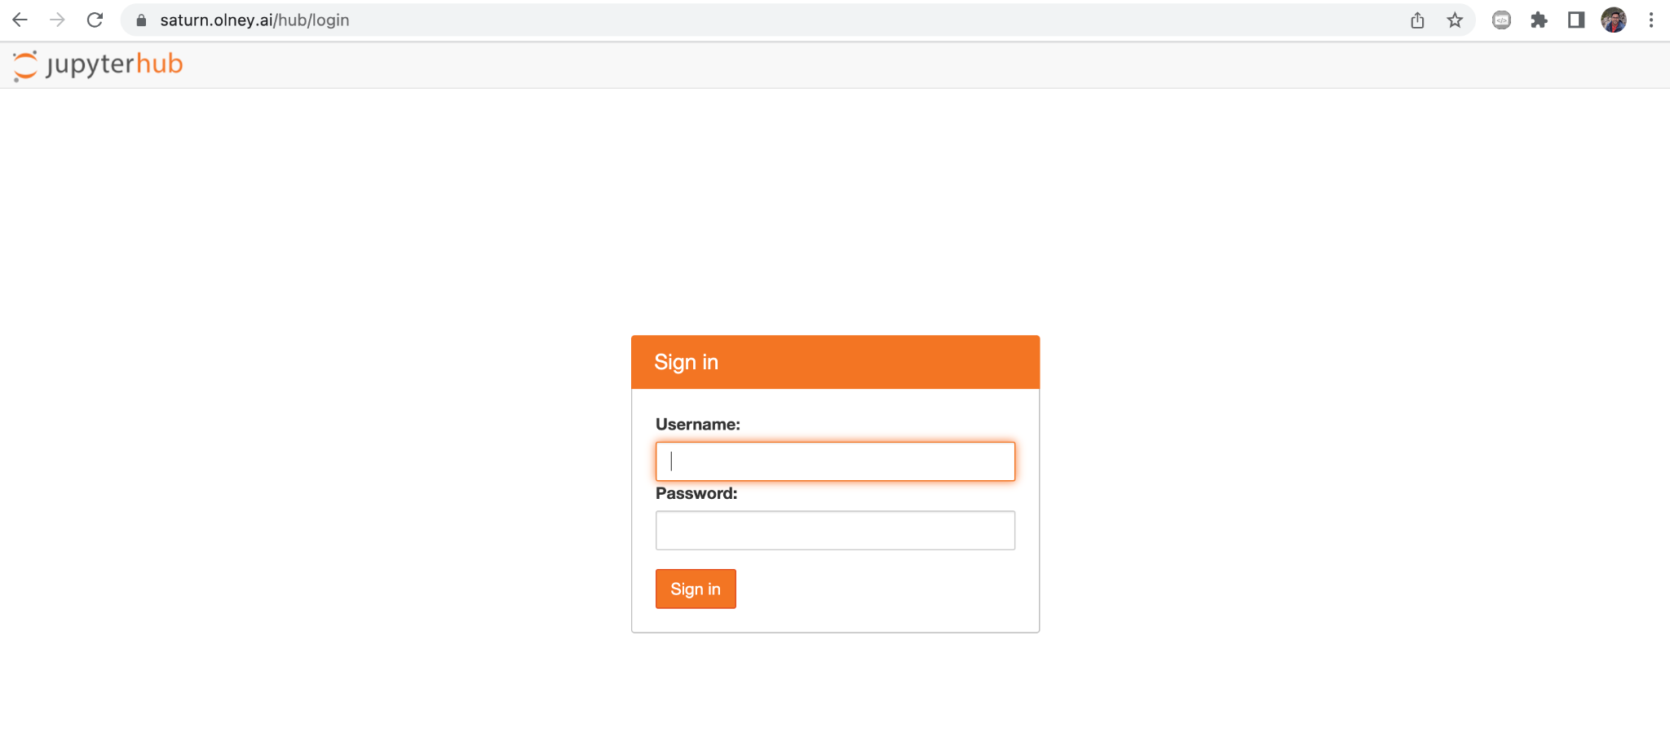
Login to Jupyterlab
Logging In to Jupyterlab at saturn.olney.ai

Slide 4
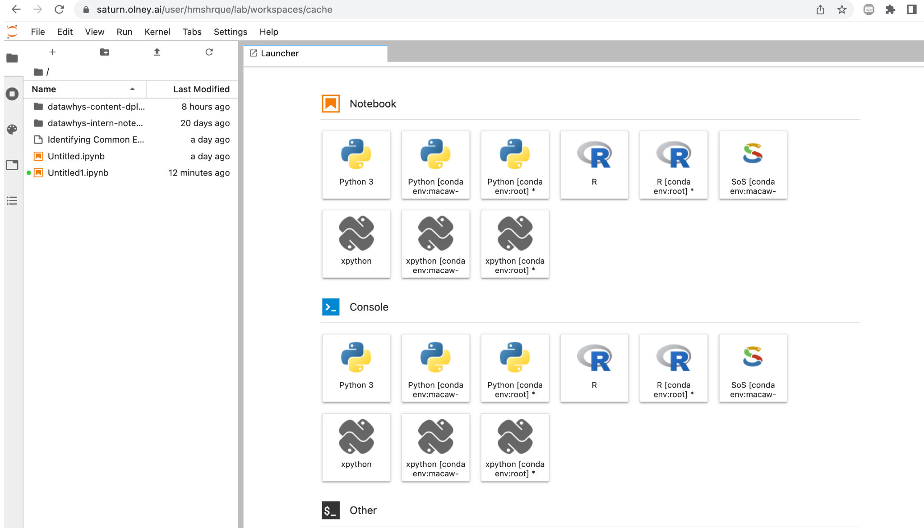

Slide 5
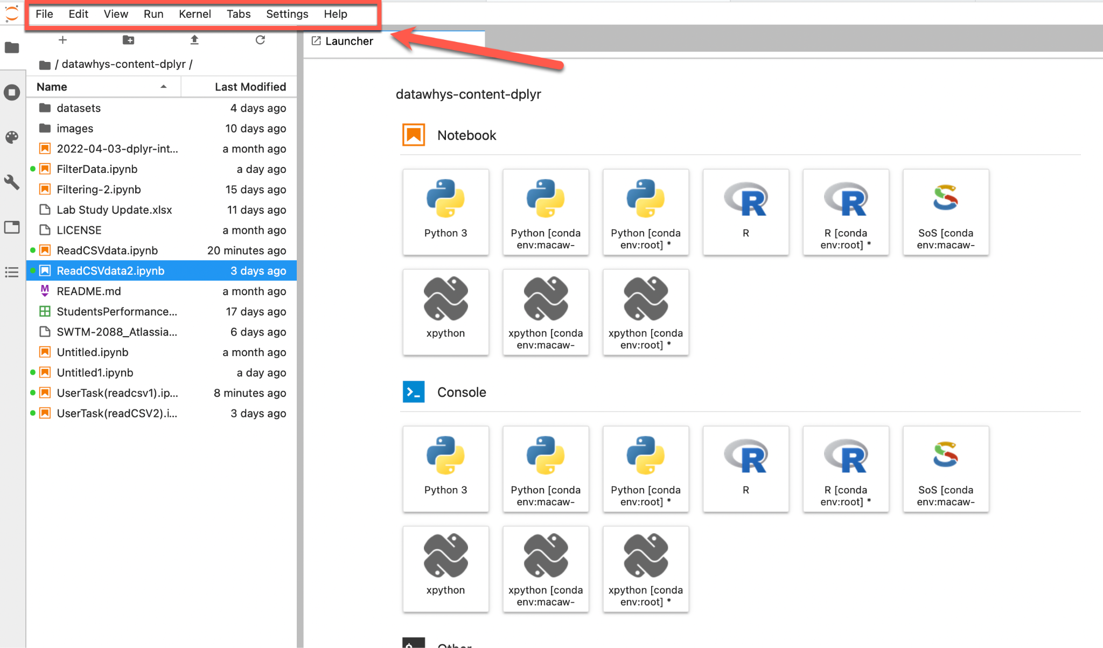
The Menu Bar
Menu Bar
Notebooks
Launcher
Console

Slide 6
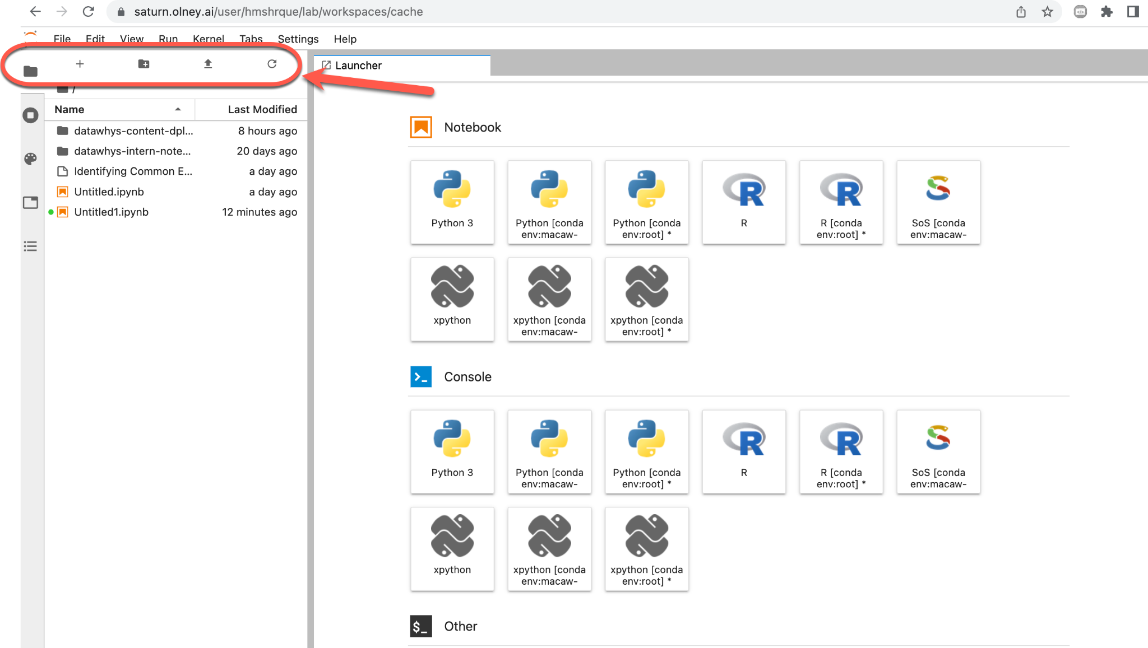
The toolbar
New Launcher
Upload Files
Refresh File List
File Browser
New Folder

Slide 7
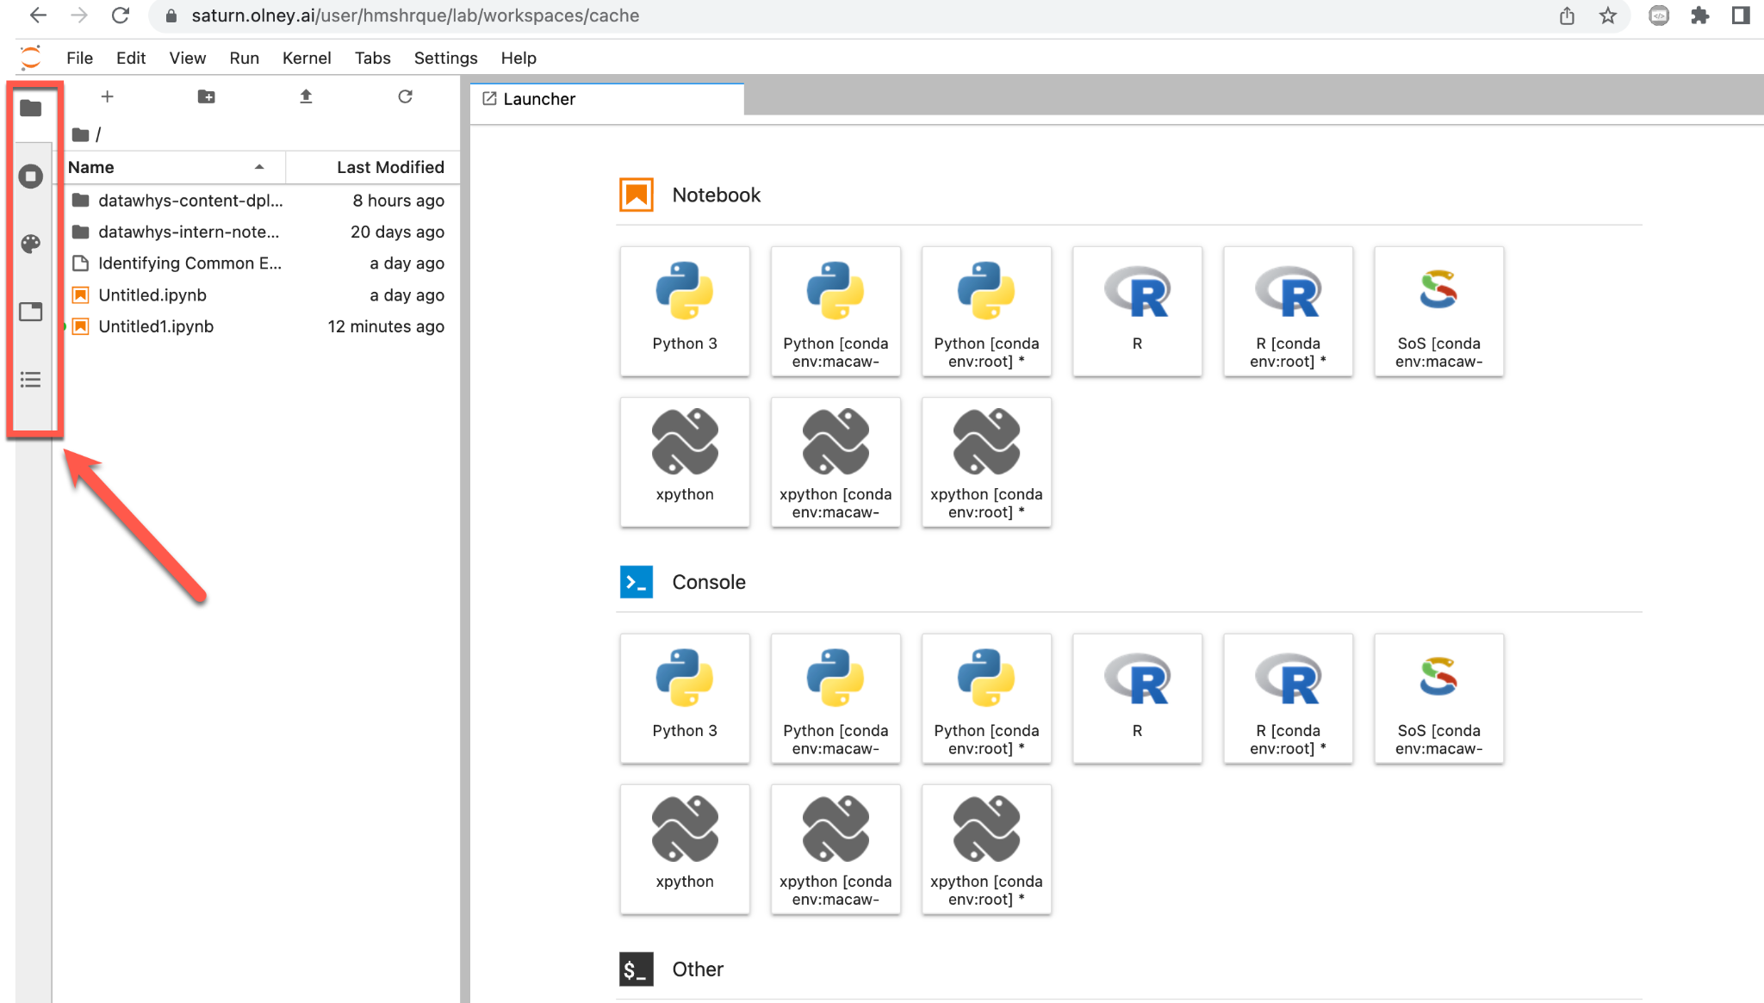
The Left Panel(side bar)
File Browser
Running Terminals and Kernels
Commands
Open Tabs
Table of Content

Slide 8
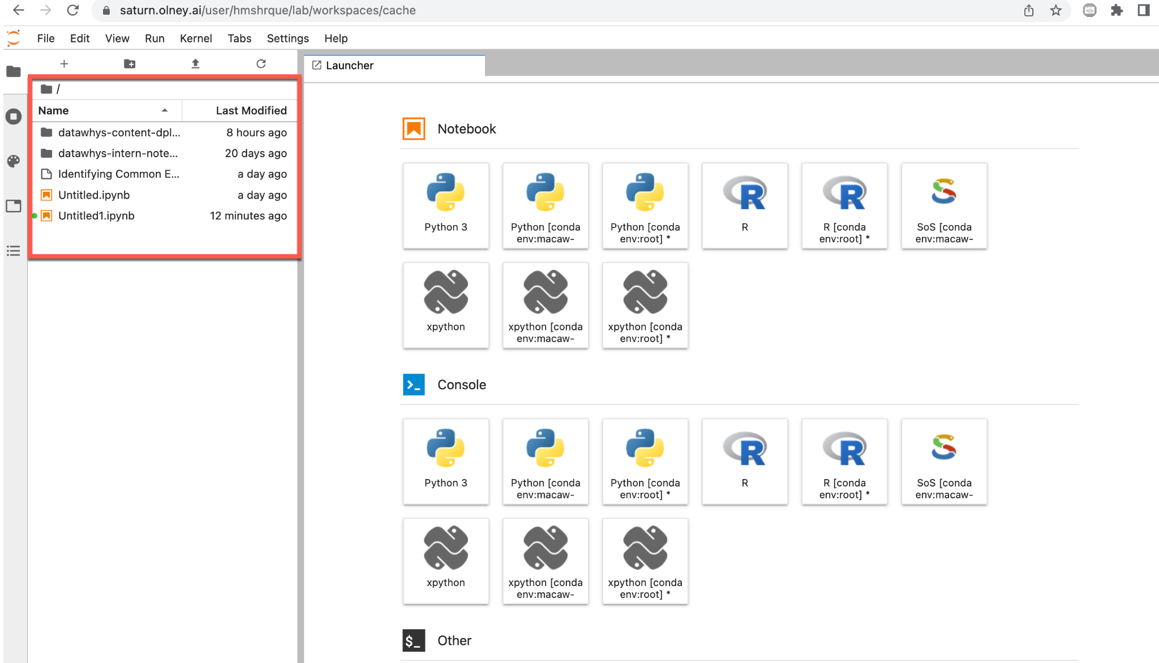
Folder Structure in Jupyterlab
File Structure

Slide 9
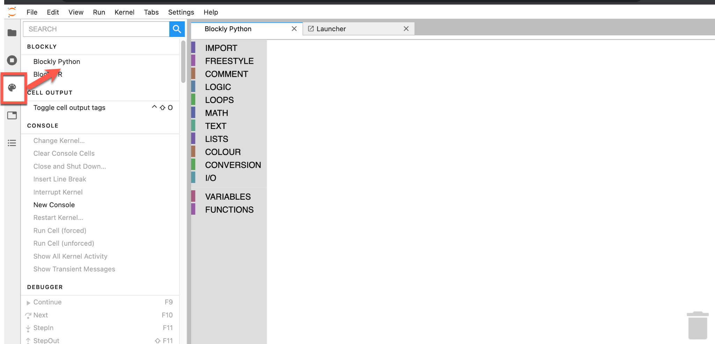
The Blockly Palette
Select on the Blockly Command Pallete to Open Blockly Python

Slide 10
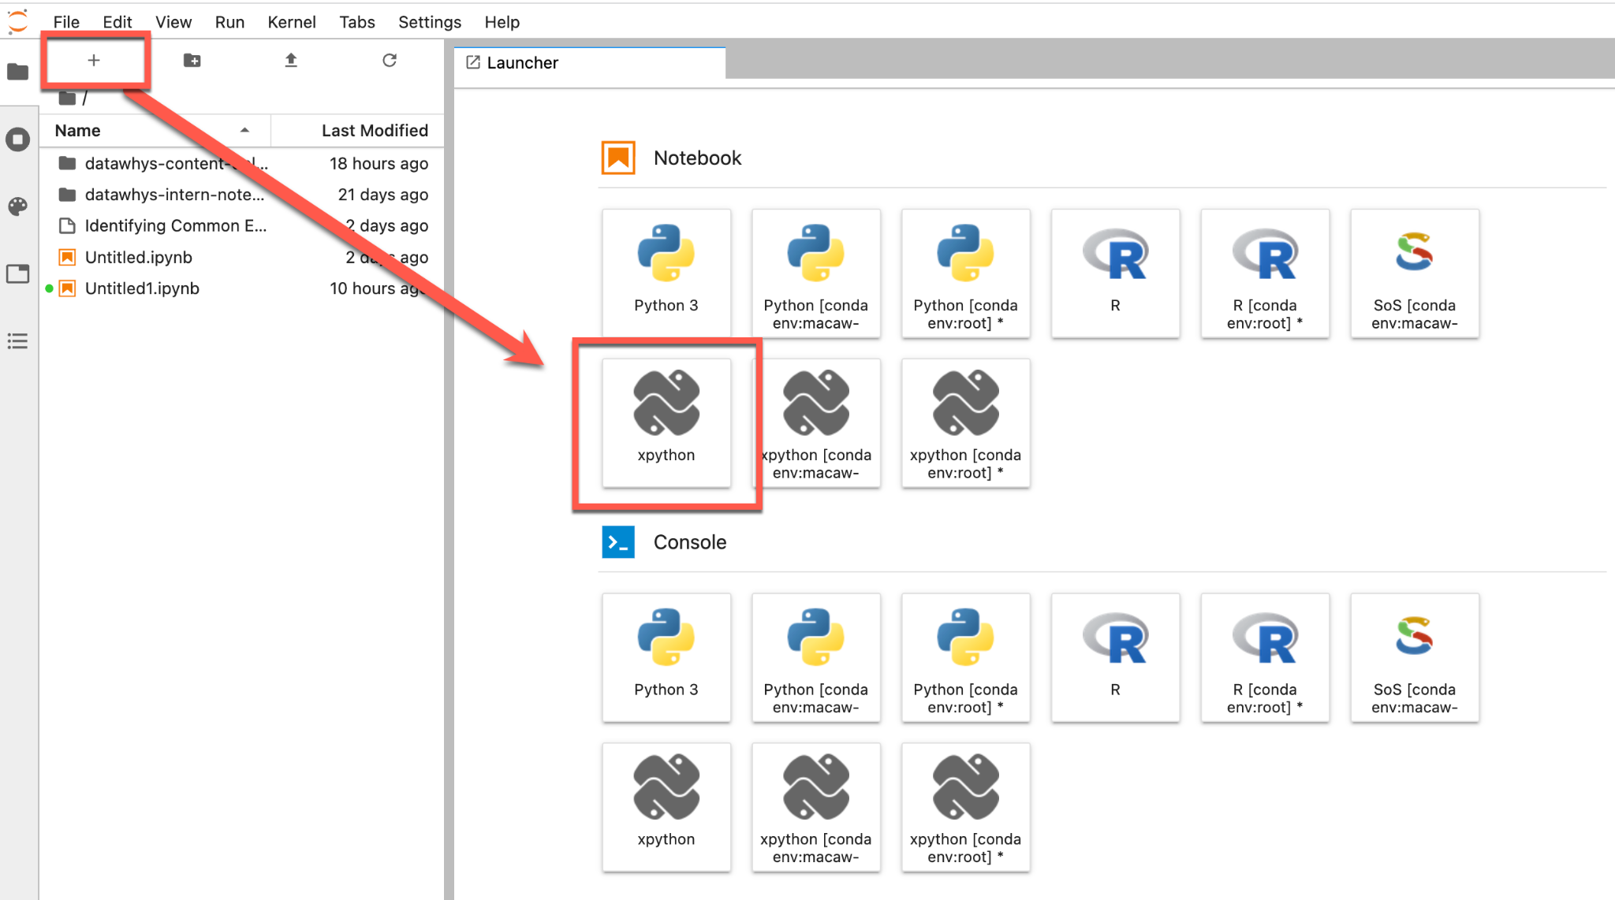
Opening python file from launcher (1)
Create a new python notebook. Select the xpython option which is the kernel that we will work on.

Slide 11
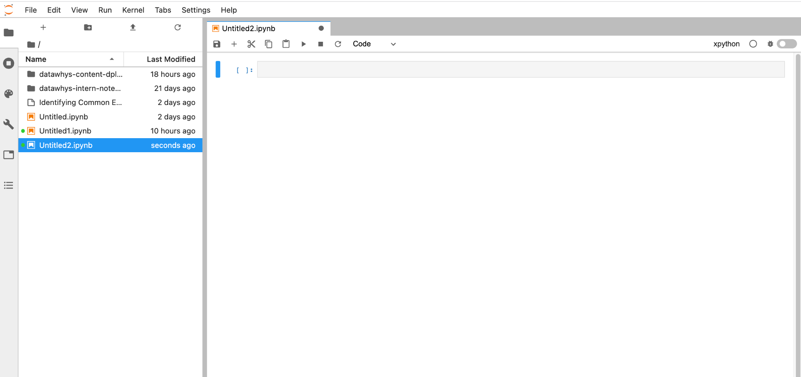
Opening python file from launcher(2)
Double click on the notebook you want
To open

Slide 12
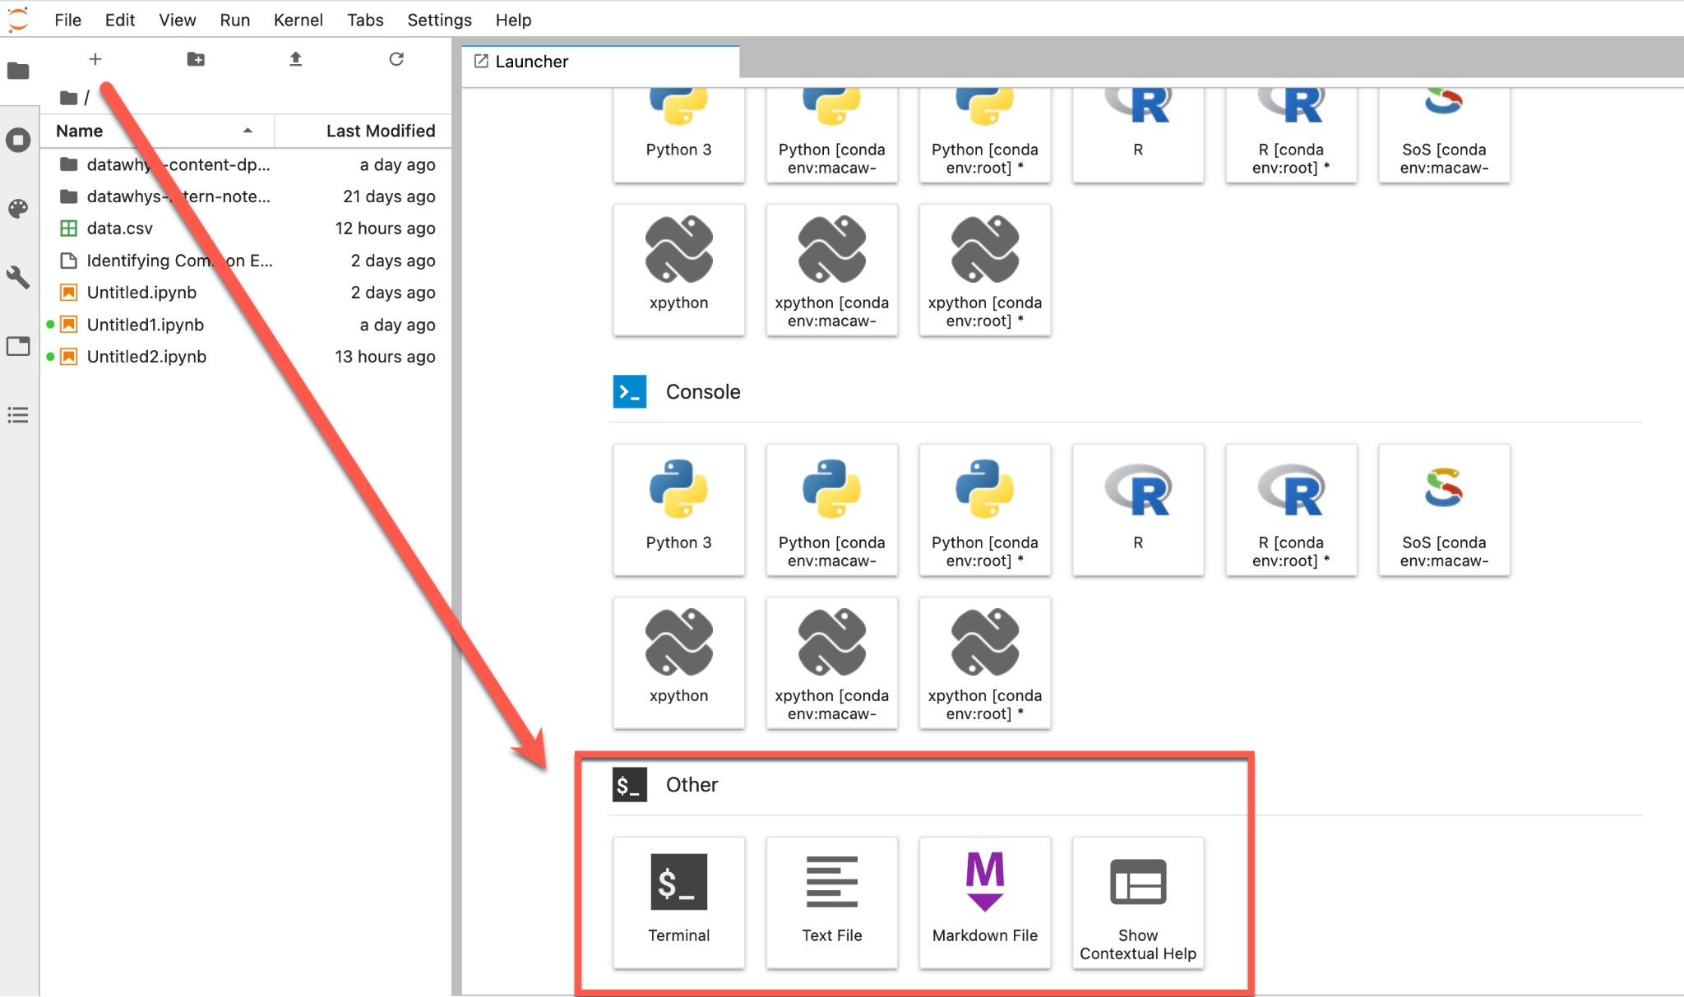
Opening other file types
You can also open other files such as terminal, text files etc. from the launcher

Slide 13
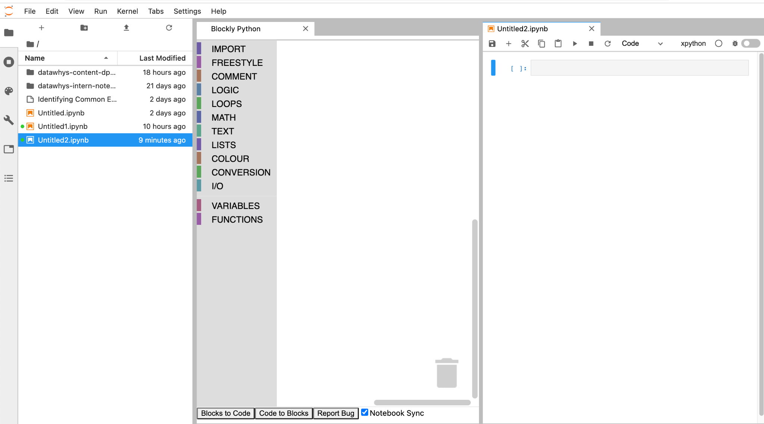
Viewing blockly and python file side by side
Open a Notebook then Click on the Command and Select "Blockly Python" to view blocky and python side by side

Slide 14
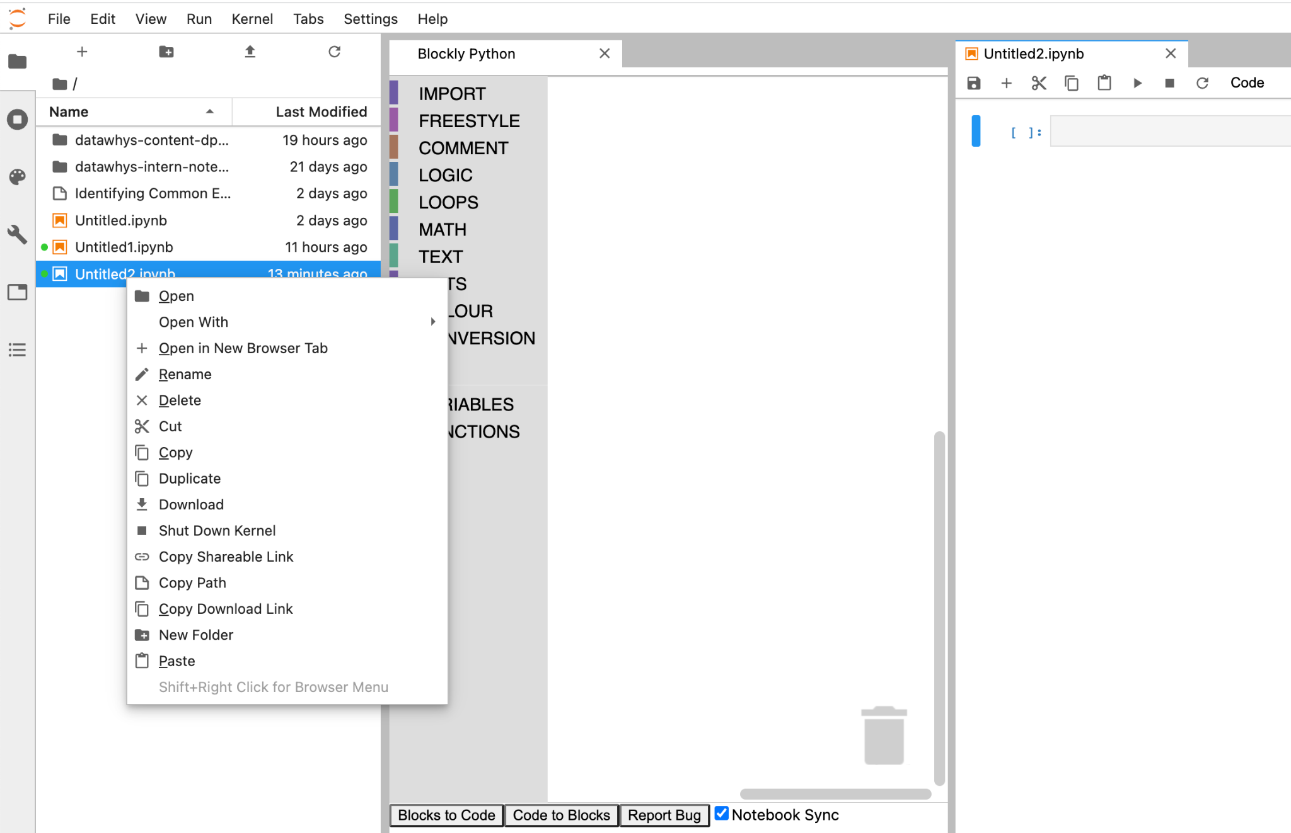
File Operations
Right Click on the file you wish to open / rename / copy etc

Slide 15
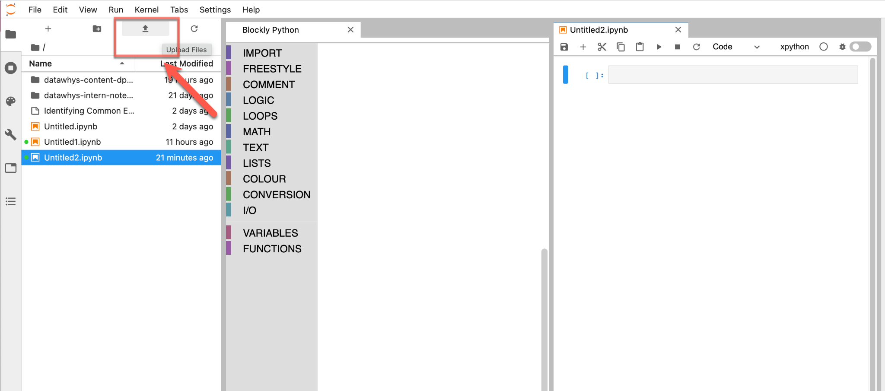
Uploading a file in Jupyterlab (1)
Click on the Upload icon (as shown by the arrow) to upload files

Slide 16
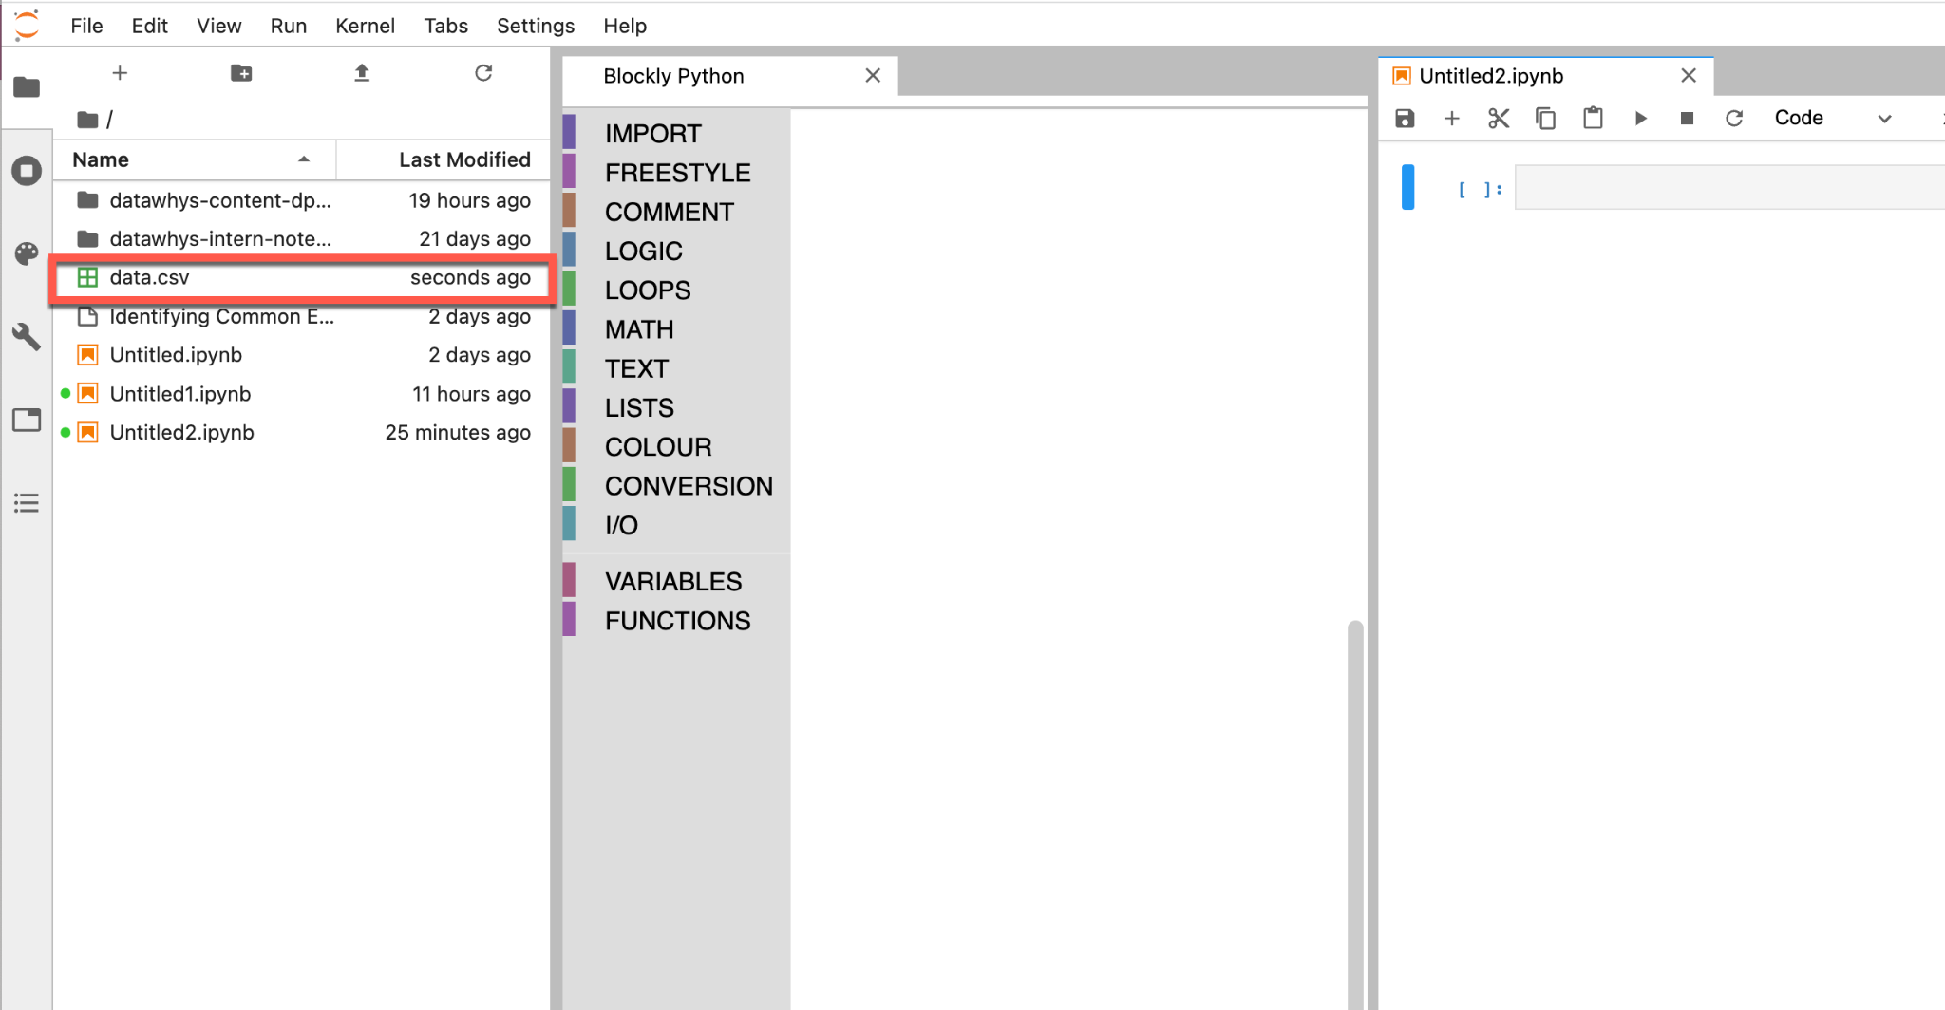
Uploading a file in Jupyterlab (2)

Slide 17
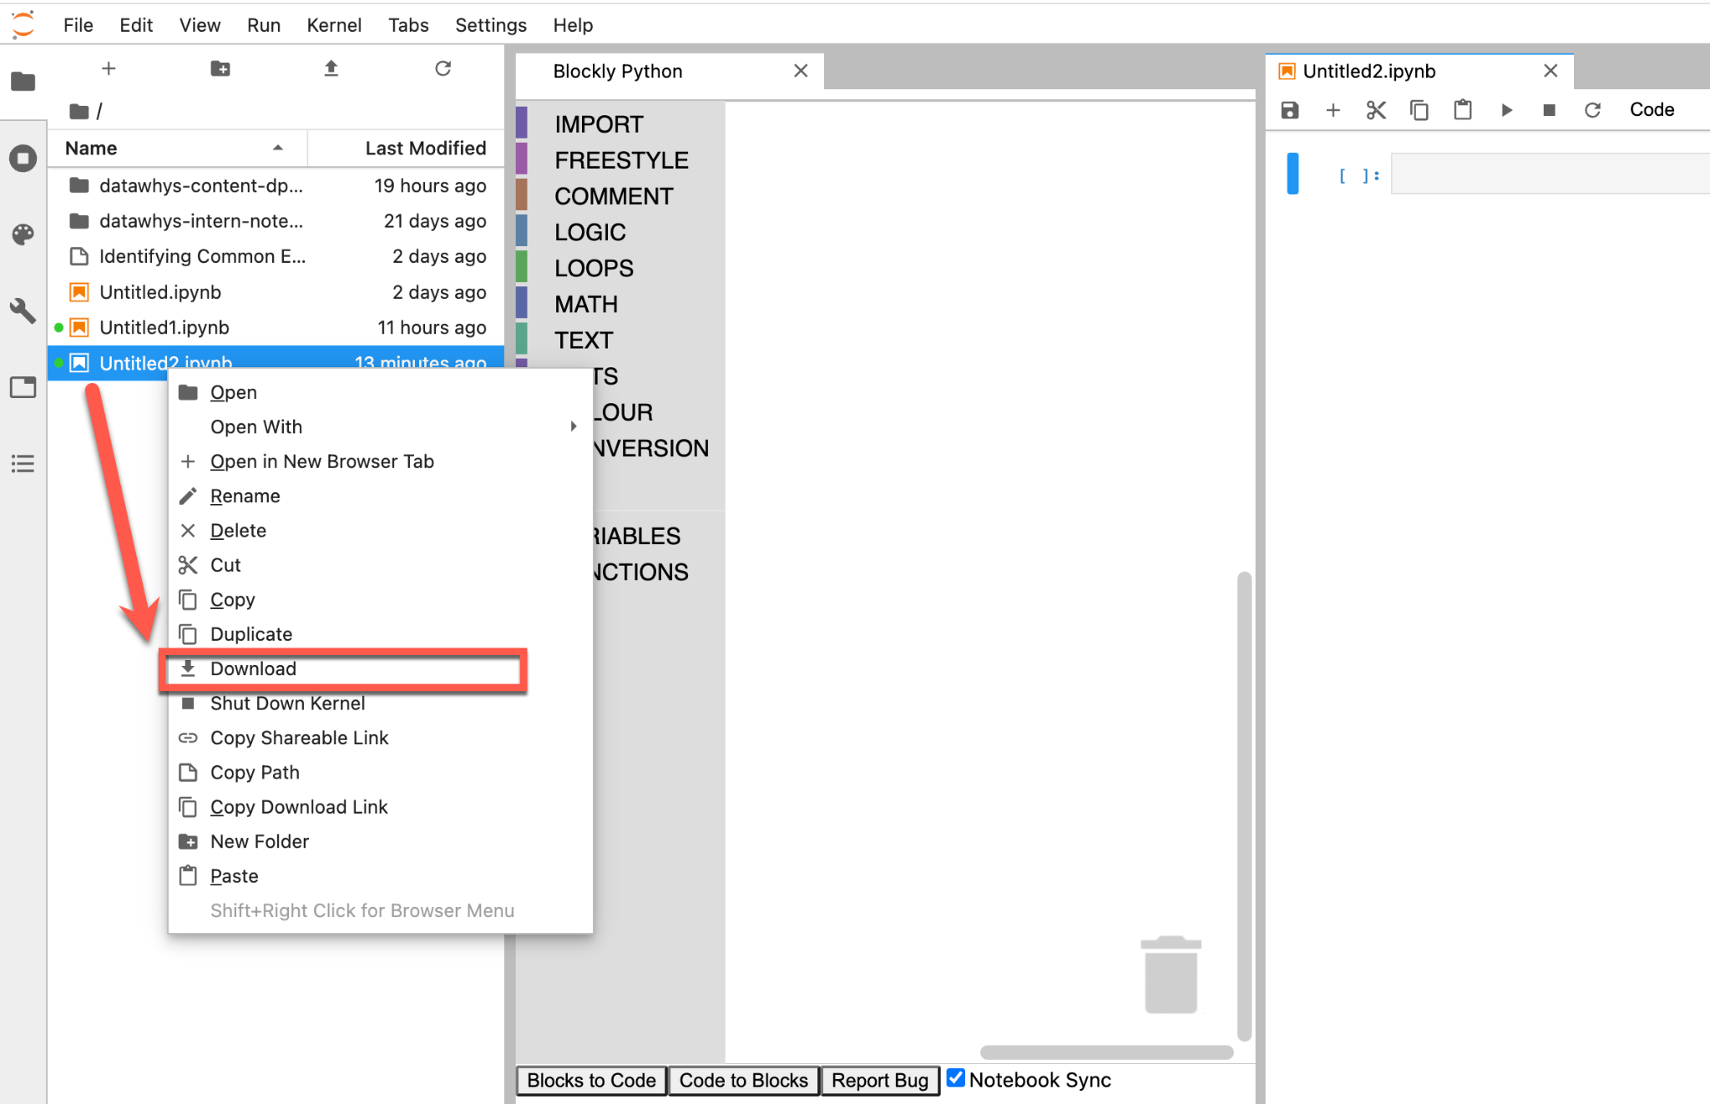
Downloading a file from Jupyterlab
Right Click on the File you wish to download and click on the Download Option

Slide 18
Practice Task:
Login into the Jupyterlab(https://saturn.olney.ai/) system with username and password.
Go to “Intro to Jupyterlab” folder
There should be test.ipynb file
Rename the file test.ipynb as “testrenamed.ipynb”
Open a xpython file from launcher and name it “createfile.ipynb”
Open a blockly palette from the side panel
Open the “createfile.ipynb” file and view the blockly palette side by side
Download the “createfile.ipynb” file
Rename the downloaded file as “upload.ipynb”
Upload the ‘upload.ipynb’ file to jupyterlab
Delete file “testrenamed.ipynb”
Check which files are open from the ‘Kernel’ tab and take a screenshot. Paste the screenshot in your pod text channel

Slide 19
Self Practice:
Login into the Jupyterlab system (wd username and password.)
Go to “Intro to Jupyterlab” folder
There should be newtest.ipynb file
Rename that file “newtestrenamed.ipynb”
Open a xpython file from launcher and name it “createfile.ipynb”
Open a block palette from the side panel
View the blocks and “createfile.ipynb” file side by side
- Download the “createfile.ipynb” file
- Rename the downloaded file “upload.ipynb”
- Upload the ‘upload.ipynb’ file to jupyterlab
- Delete the “newtestrenamed.ipynb” file
- Check which files are open from the ‘Kernel’ tab and take a screenshot. Paste the screenshot in your pod text channel

